Slide 1
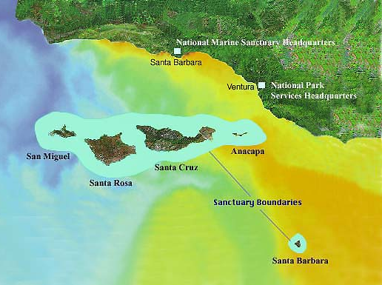
Notes:
Channel Islands National Park encompasses 5 of the 8 Southern California Channel Islands - Santa Barbara, and the 4-island complex of San Miguel, Santa Rosa, Santa Cruz and Anacapa …

Slide 2
Santarosae
Notes:
… that once were joined into a single island called Santarosae during the low sea levels of the Pleistocene glacial ages. The origin of all 8 Channel Islands is linked to the evolution of the San Andreas transform plate boundary, but each island has unique geologic characteristics as well. In this lesson we will explore the geology of each island separately, starting with Santa Barbara and working west to San Miguel, while gradually piecing together the large scale geologic story.

Slide 3
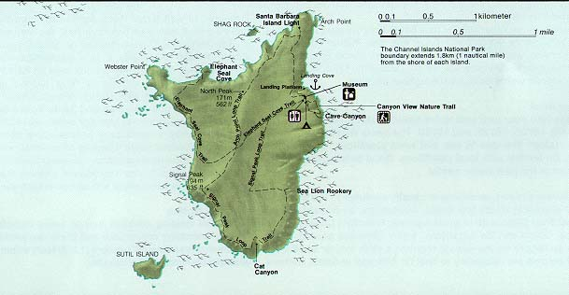
SANTA BARBARA
1 mile
Notes:
At only about a mile across, Santa Barbara is the smallest of the 8 channel islands. Its tiny size …

Slide 4
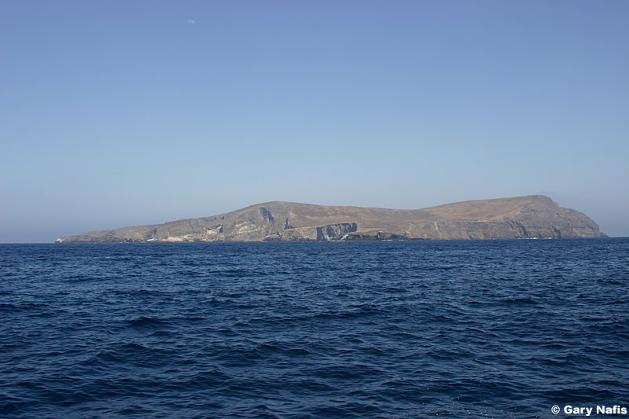
Small and Dry
Notes:
… combined with the general aridity of Southern California …

Slide 5
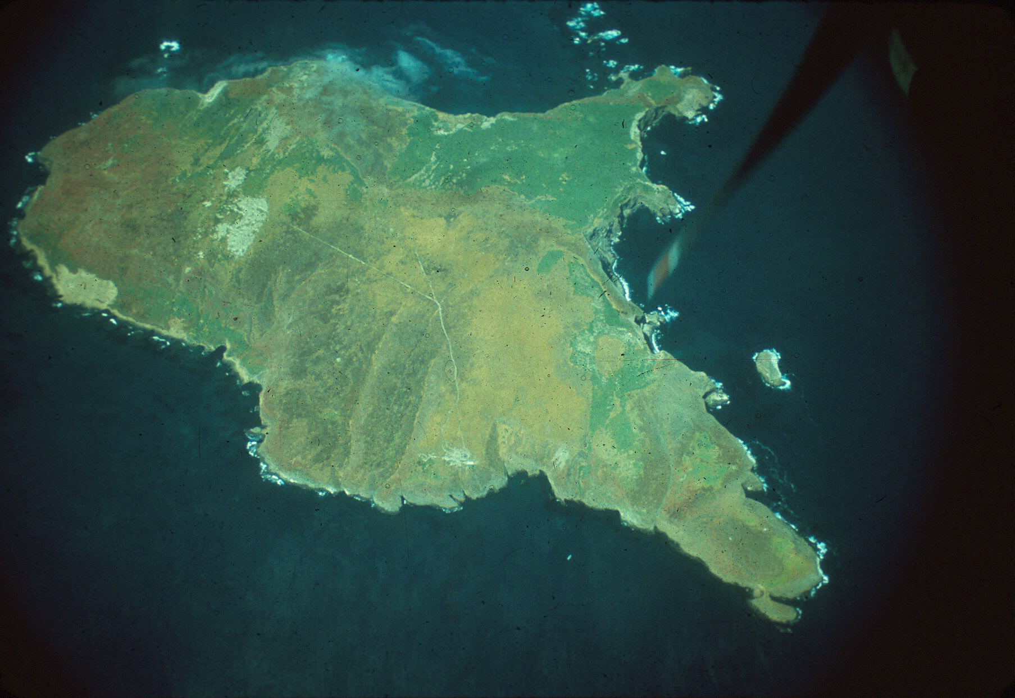
No rivers
Notes:
… explain why there are no rivers on the island. Without rivers, virtually no sediment is carried from the interior of the island to the shore, …

Slide 6
No rivers
No beaches
Notes:
… so there are no sandy beaches anywhere on the island. These conditions are somewhat true of all the islands, but they are especially important on tiny Santa Barbara Island.

Slide 7
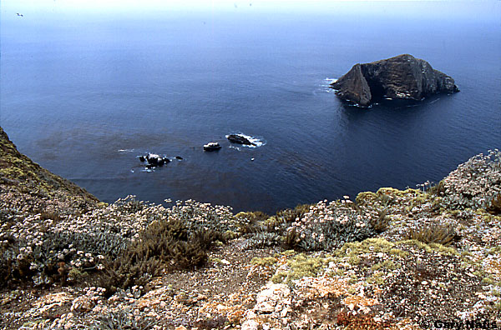
No beaches = No wave protection = Massive cliffs
Notes:
Without beaches, waves crash directly on the rocks – undercutting them until they fall into the sea to create precipitous cliffs.

Slide 8
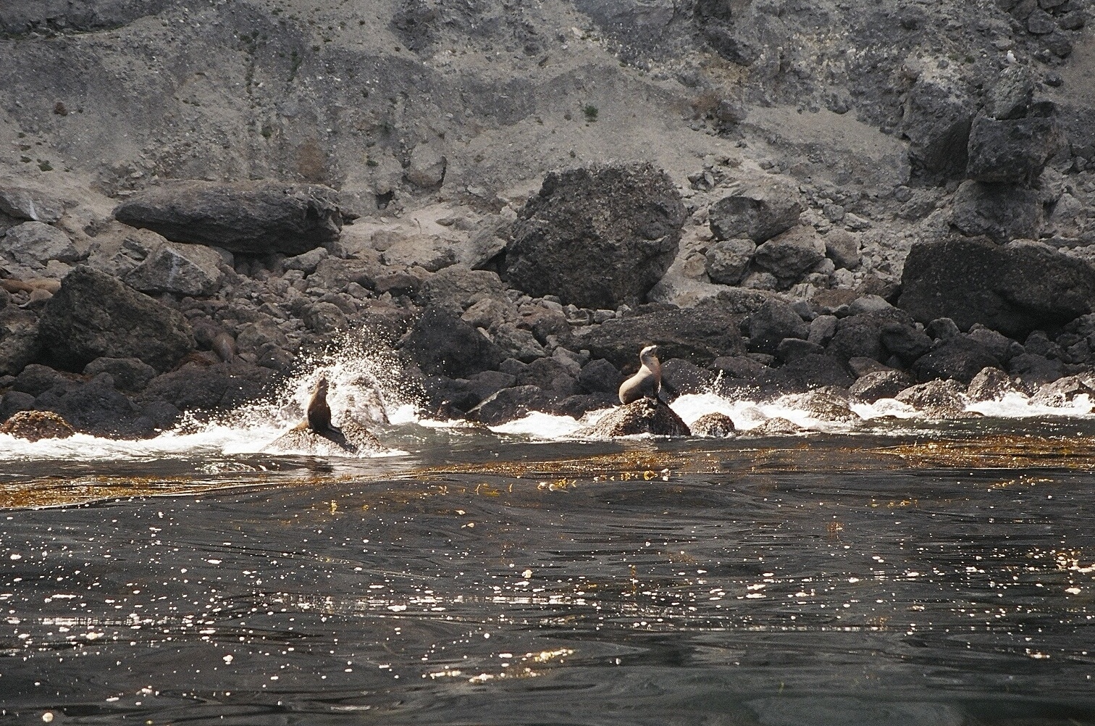
Notes:
This is a typical Santa Barbara Island “beach” made of boulders that have fallen from the cliffs above. These boulders will eventually be worked into deep water by wave action which will once again undercut the cliff and cause more rock falls. Providing lots of nooks and crannies to shelter sea life as well as heavy anchors for kelp, such boulders contribute to the rich habitat that supports the island’s thriving sea lion colony. Fortunately, for the sea lions, rock falls are relatively infrequent.

Slide 9
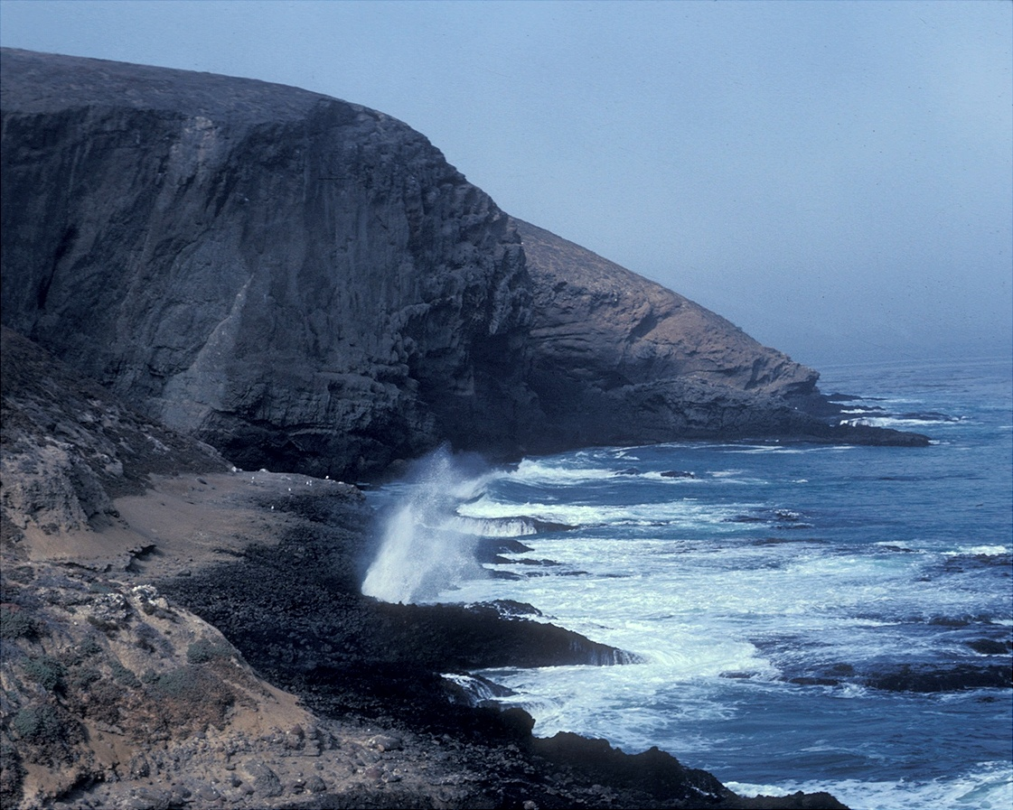
Cliffs require hard rock
Notes:
In fact, the cliffs must be made of a pretty hard rock or else they would just collapse under their own weight like a pile of sand. Judging from the hardness, dark color and subtle layering (look near the base of the cliff here) you may have already pegged these rocks as basalt.

Slide 10
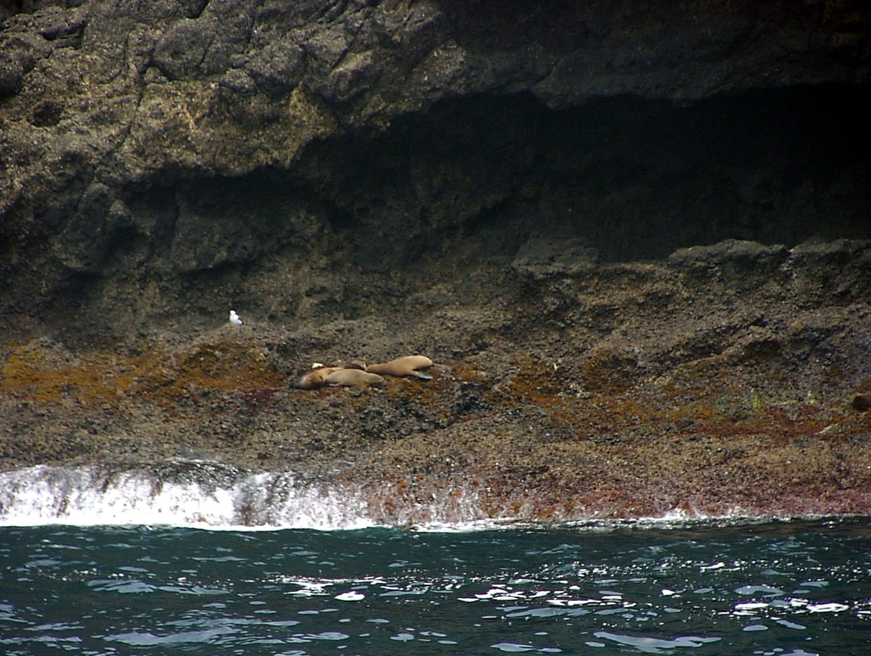
Notes:
If you look closely at the basalt in the upper portion of this photo you can make out several rounded lobes, ….

Slide 11
Pillow lava
Notes:
… which you may recognize as pillow lava.

Slide 12
Pillow lava
…zzz
zzzz…
Notes:
Although the sea lions are not resting on the pillows, mere proximity is enough to induce the narcotic effect.

Slide 13
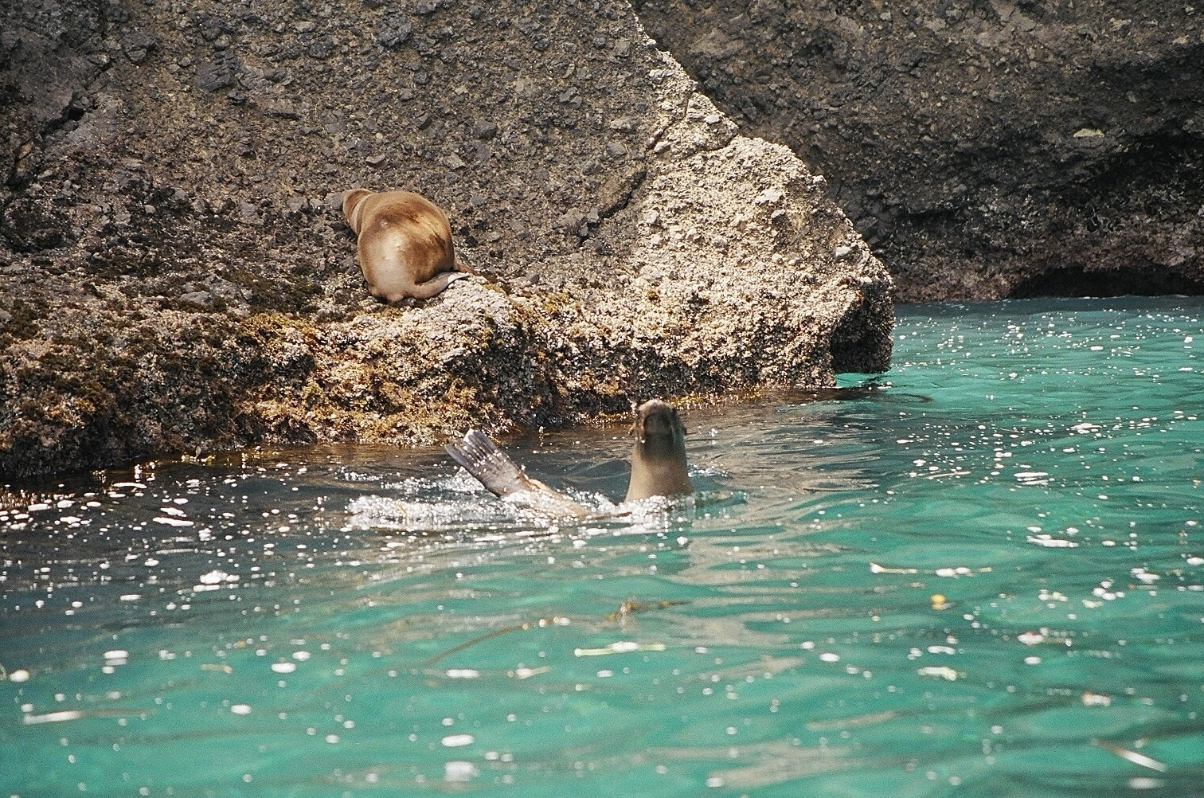
Notes:
A closer look shows that the rocks at the base of the cliff are comprised of angular basalt fragments, ash and marine mud.

Slide 14
Volcanic breccia
Notes:
The rock is called volcanic breccia …

Slide 15
It’s important to be really tired if you have to sleep on volcanic breccia.
Notes:
…

Slide 16
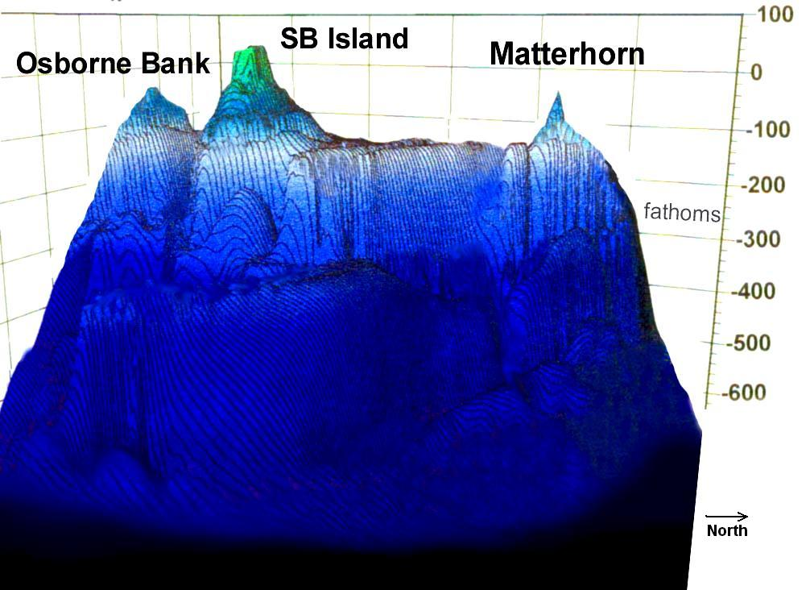
(Vertical exaggeration = 30X)
Notes:
… and the assemblage with pillow basalt implies both effusive and explosive submarine volcanism. That’s important because it means that the island was not built above sea level. Like the nearby “Matterhorn” and Osborne Bank, Santa Barbara Island grew from the deep ocean floor as a volcanic seamount. Unlike the Matterhorn and Osborn Bank, however, Santa Barbara Island became exposed above sea level by a combination of volcanic growth and uplift along faults.

Slide 17
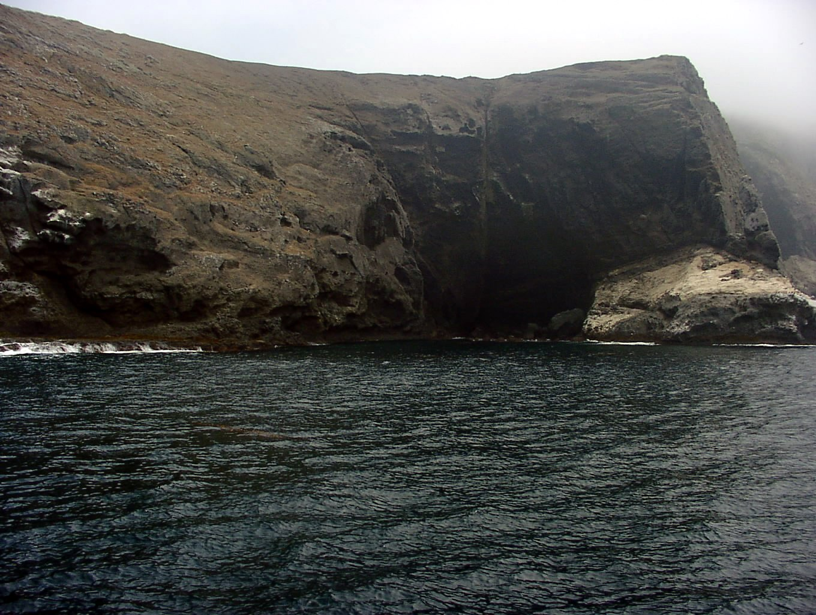
Notes:
Faults like these are important not only in the uplift of Santa Barbara Island, but all of the channel islands were uplifted by faulting.

Slide 18
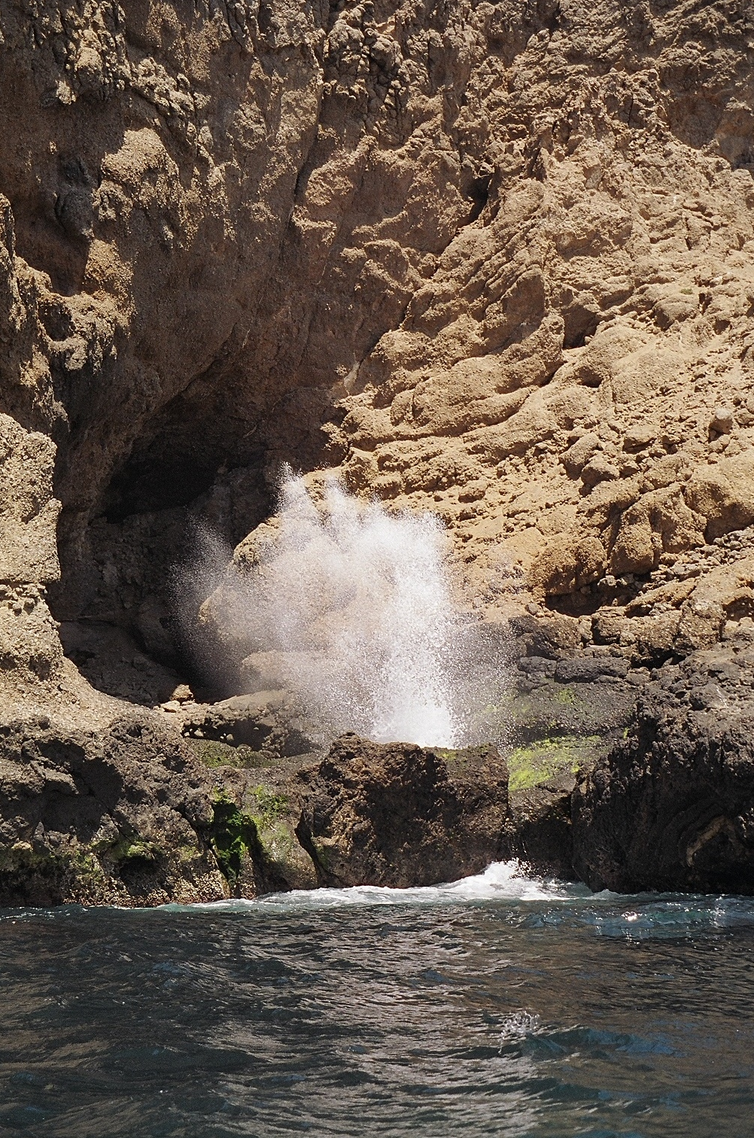
Notes:
Such faults contribute to the differential erosion of Santa Barbara Island by wave action. Here, a sea cave and blow hole have formed along the fault-weakened volcanic rock. Notice that the bulk of the cave is above sea level, …

Slide 19
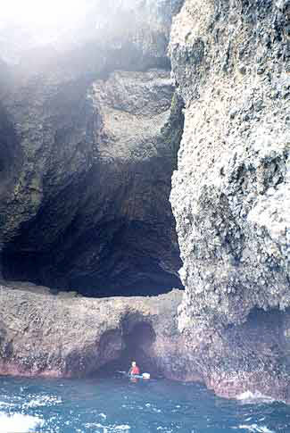
Notes:
… as is this cave, suggesting uplift of the island …

Slide 20
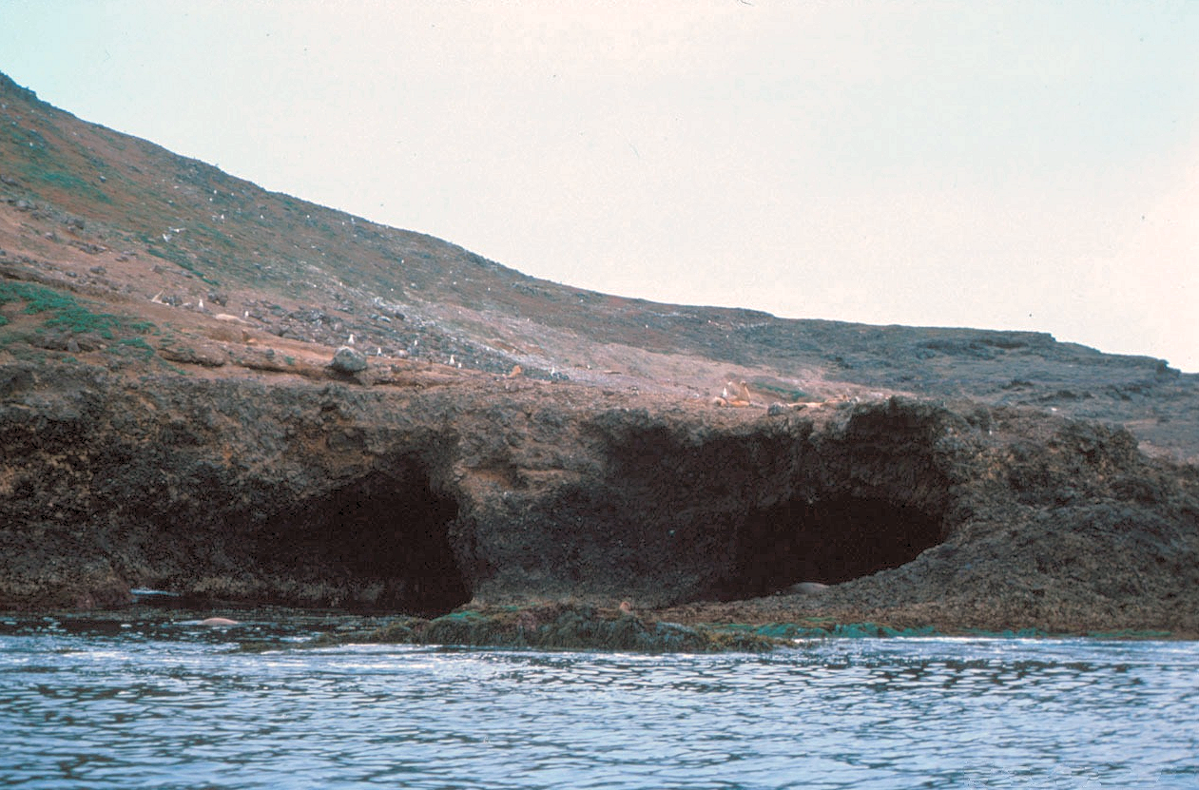
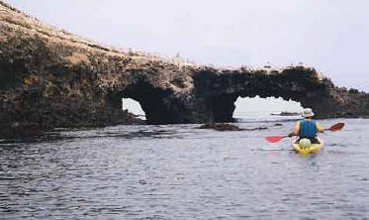
Notes:
… because sea caves typically form near sea level. This pair of young sea caves on Santa Barbara Island was carved into the relatively soft volcanic breccia. Notice the marine terrace above these caves. Like the elevated sea caves they are yet another indication of emergence.

Slide 21
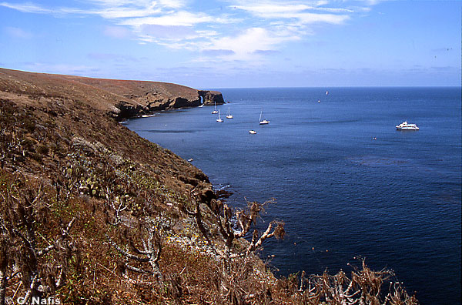
Notes:
During different periods of the uplifting process, wave erosion caused several marine terraces which are evident today. The broad, flat surfaces promote soil formation on the underlying nutrient-rich volcanic rocks, such that during unusually rainy periods …

Slide 22
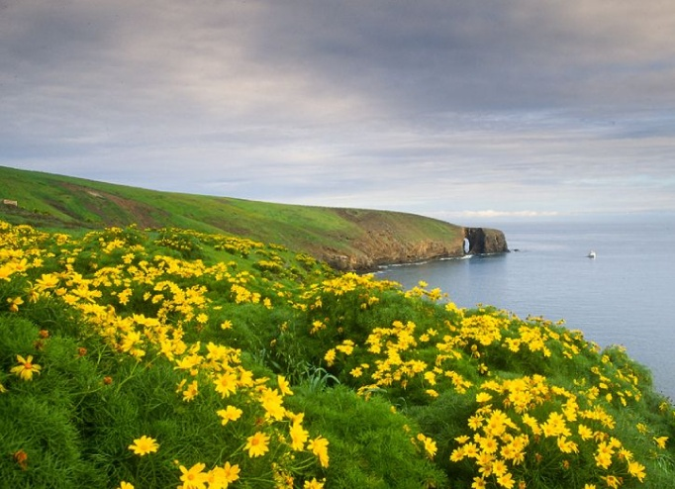
Notes:
... spectacular blooms of native sunflower occur.

Slide 23
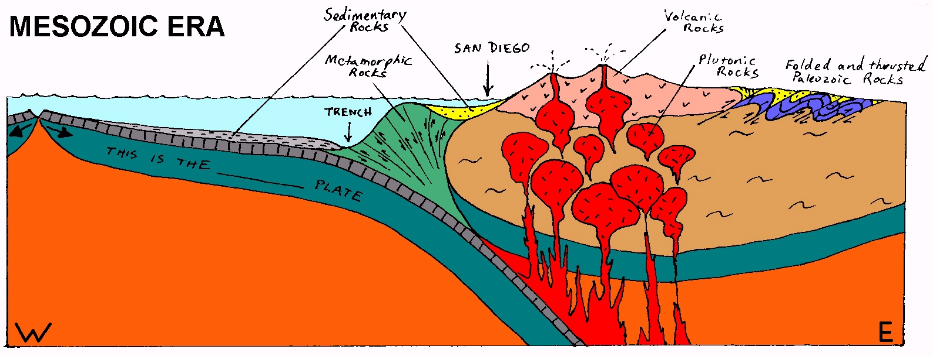
Farallon
Accretionary Wedge and Forearc Basin Sedimentation
Notes:
The origin of Santa Barbara Island is similar to that of all the channel islands and begins with the subduction of the Farallon Plate during the Mesozoic Era. Rocks formed in the accretionary wedge and forearc basin here are not exposed on Santa Barbara Island, but play an important role in the formation of other channel islands.

Slide 24
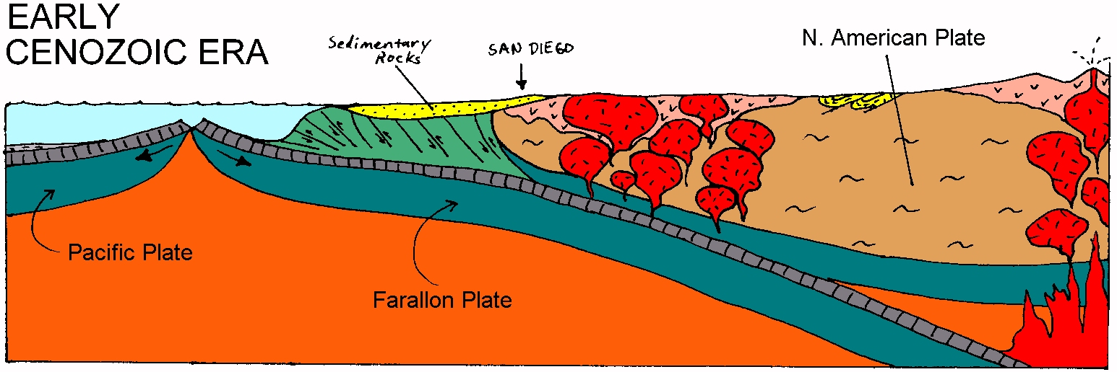
East Pacific Rise
EPR approaches, forearc basin becomes more terrestrial
Notes:
In the Early Cenozoic, the East Pacific Rise approaches the trench while the erosion of the continent causes sedimentation in the forearc basin to become more terrestrial.

Slide 25
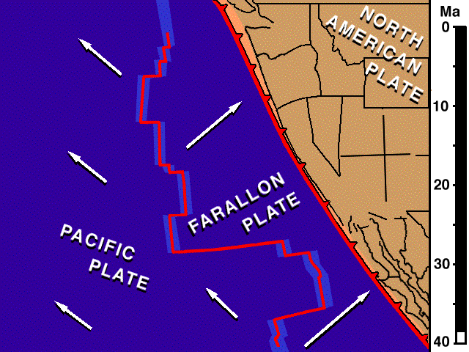
Notes:
Because the East Pacific Rise moved north as well as east, the Pacific and Farallon Plates had a northerly component superimposed on their divergence from the East Pacific Rise. The resultant motion of the Pacific Plate was therefore towards the northwest. Since this was parallel to the orientation of the trench, when the Pacific Plate arrived at the trench, the plate boundary changed from convergent to transform. As more of the Pacific Plate was brought into contact with the North American Plate, the transform plate boundary lengthened into the San Andreas Fault. The conversion to a transform plate boundary removed compressive stress on the western margin of North America, which allowed it to spread laterally while shear stress from the Pacific Plate ripped off great hunks of the North American Plate (like Baja California) and carried them to the northwest.

Slide 26
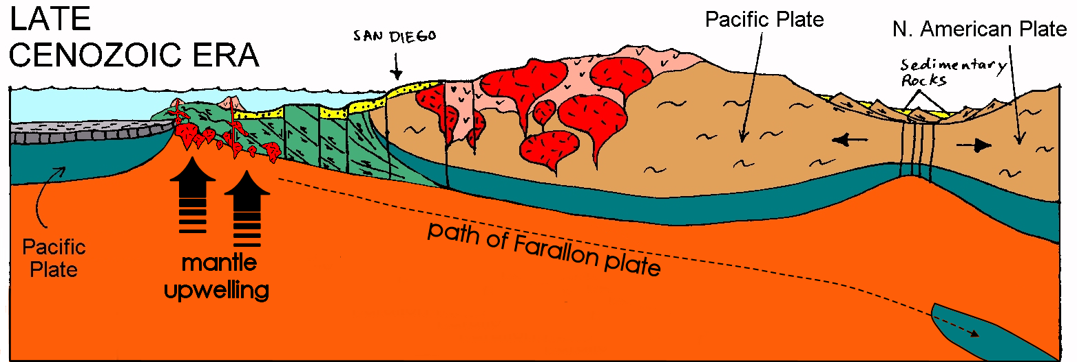
Formation of Oceanic Crust Ends
Notes:
When the East Pacific Rise arrived at the trench production of oceanic crust ended because divergence no longer took place there and the accretionary wedge and forearc basin were thrust over the former spreading center.

Slide 27
Mantle Upwelling in Wake of Farallon Plate
Notes:
Because no new oceanic crust replaces the subducting Farallon Plate, mantle wells up to replace the area formerly occupied by the Farallon Plate.

Slide 28
Decompression Melting and Basaltic Magmatism
Notes:
Decompression melting takes place in the upwelled mantle, producing basaltic magma that works it’s way towards the surface. Some is emplaced as small, shallow plutons, but the thin crust allows much basaltic magma to reach the sea floor where it erupts as pillow lavas and volcanic breccias. Notice the numerous fault in the continental borderland. Like the San Andreas, motion along these faults is primarily strike slip, but vertical motion also occurs where bends occur along the fault’s length.

Slide 29
Notes:
Looking down now on a bend along a right lateral strike slip fault, we can see that, depending on which direction the fault bends, localized areas of compression and extension will occur.

Slide 30
Transpression
Transtension
Notes:
Compression associated with lateral fault motion is known as transpression and the corresponding extension is called transtension.

Slide 31
Thicker crust
Thinner crust
Notes:
Crust tends to thicken in areas of transpression, while crustal thinning occurs where there is transtension.

Slide 32
Uplift
Subsidence
Notes:
Transpressional areas therefore tend to undergo uplift and ridge formation, while transtension causes subsidence and the formation of basins.

Slide 33
Ridge
Basins fill with volcanics
Notes:
Because crustal thinning contributes to the decompression of the underlying mantle, basaltic magma tends to form beneath the transtensional basins. Such magma reaches the surface as pillow lava and volcanic breccia which fills the basin.

Slide 34
Continental Borderland
Notes:
Although such volcanism is especially common in the sheared and thinned crust of the Southern and Baja California continental borderland …

Slide 35
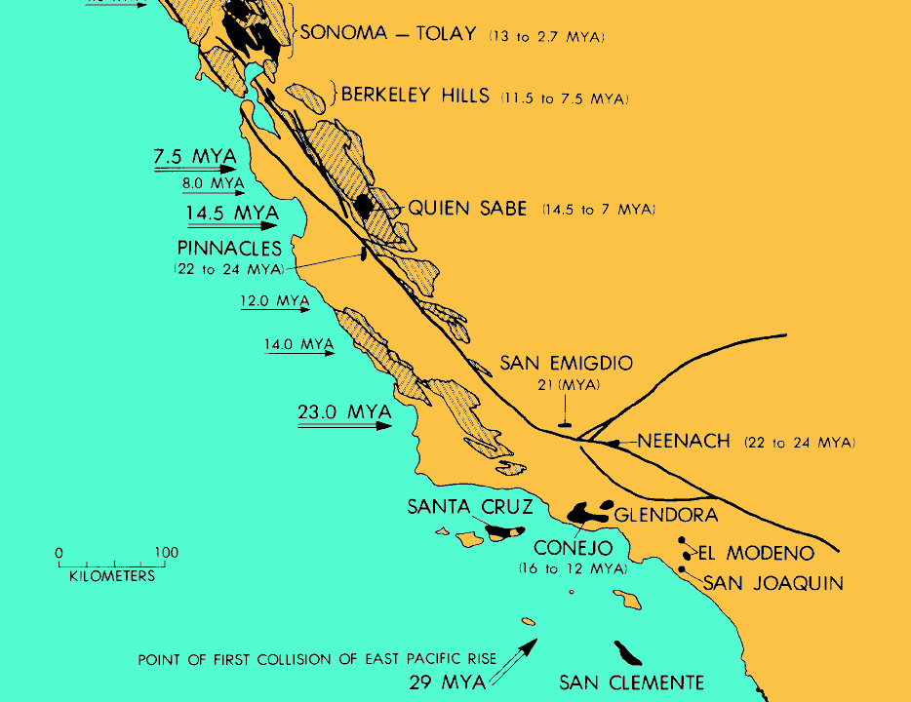
Neogene volcanic centers (black)
Notes:
… Neogene volcanic centers (shown in black here) are found along the entire length of the San Andreas, …

Slide 36
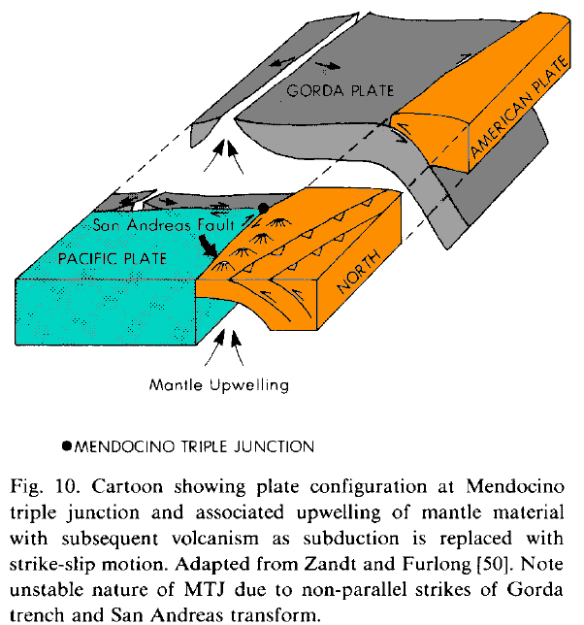
San Andreas Fault
Mantle upwelling
Notes:
… because the formation of the San Andreas was accompanied by mantle upwelling in the wake of the subducted Farallon Plate.

Slide 37
Transtensional Basin
Transpressional Ridge
Transtensional basins open in continental borderland
Notes:
So the continental borderland of southern California is comprised of transpressional ridges and transtensional basins filled with volcanic and sedimentary rocks. As lateral motion continues on these faults, ….

Slide 38
Transtensional Basin can become Transpressional Ridge
Stress patterns can change
Notes:
… stress patterns can reorient such that transpression may be applied to areas that formerly were subject to transtension. If that happens, the volcanic and sedimentary rocks that filled the transtensional basins can be uplifted and potentially exposed as islands. The volcanic rocks on Santa Barbara Island were exposed in this way, as is the case for uplift of most of the Channel Islands.

Slide 39
Santarosae
Notes:
At this point we will examine the four northern channel islands that make up Santarosae, as each add detail to the general tectonic framework outlined for the evolution of the continental borderland here.

Slide 40
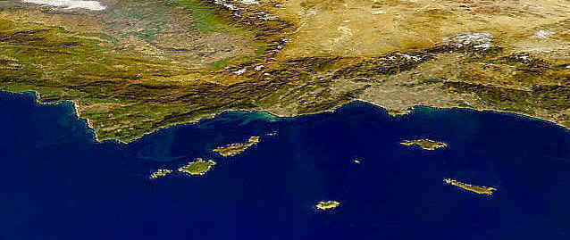
Santa Monica Mts.
Santarosae
Santarosae and Santa Monica Mountains share recent history, not ancient history
Notes:
Because of their alignment, geologists once considered the northern channel islands to be simply a westerly continuation of the Santa Monica Mountains. But as the geology of the Santarosae became better understood, it became apparent that the geologic connection between the two regions was only valid for their relatively recent and ongoing uplift. Prior to that uplift, however, Santarosae had a strikingly different history, which we will piece together by examining the geology of each northern channel island separately.

Slide 41
ANACAPA
Notes:
First let’s have a look at the remarkably long and narrow Anacapa Island. It’s more than five miles long, yet covers barely a square mile of area. Anacapa is so narrow that wave erosion has severed it in a couple places …

Slide 42
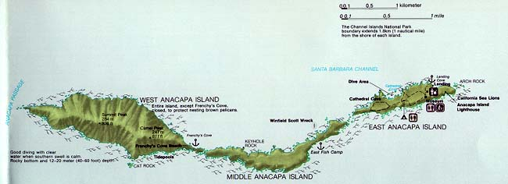
Three islands comprise Anacapa
Notes:
… such that actually three islands comprise Anacapa – East, Middle and West Anacapa.

Slide 43
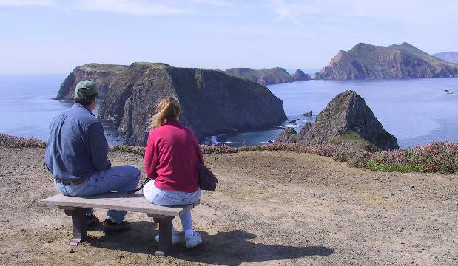
Inspiration Point
Notes:
Looking towards West Anacapa Island in the background from Inspiration Point on East Anacapa Island, you can see the flattened top of Middle Anacapa Island just above this couple.

Slide 44
Marine terrace
Inspiration Point
Notes:
No doubt they recognize that the flat area as a marine terrace and are truly inspired by the implication that Anacapa emerged from the sea floor just like Santa Barbara Island did.

Slide 45
Oh yes! This is much better than the proposal I was expecting!
Inspiration Point
Notes:
…

Slide 46
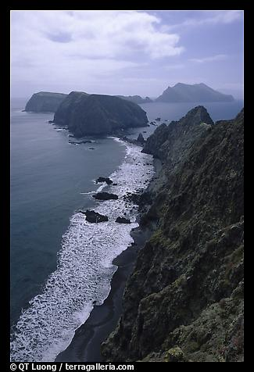
Notes:
Looking down from Inspiration Point you can see that the channel between East and Middle Anacapa Island …

Slide 47
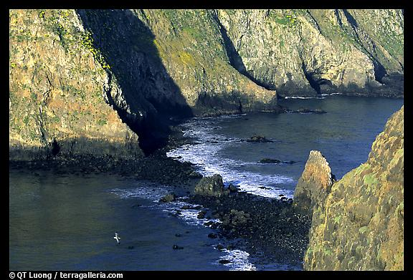
Notes:
… is actually exposed at low tide. Not long ago a sea arch may have connected the two islands …

Slide 48
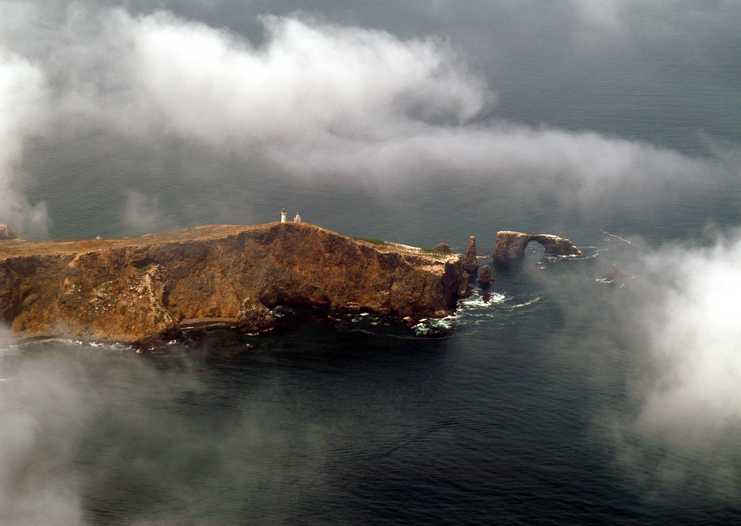
Notes:
… much like picturesque Arch Rock, at the east end of East Anacapa.

Slide 49
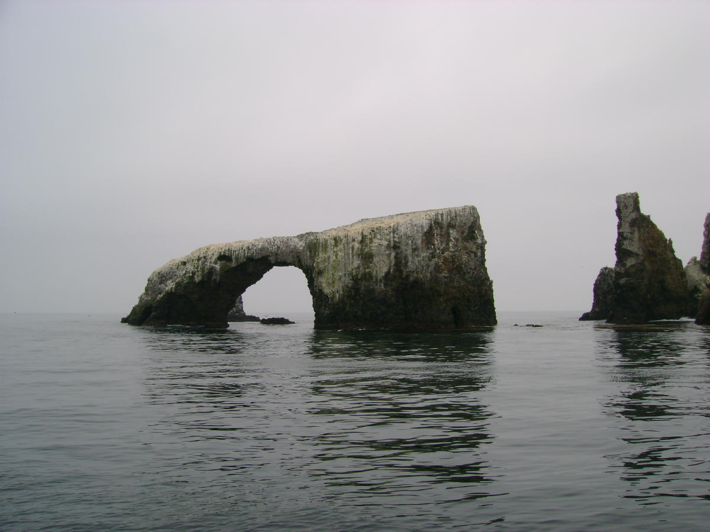
Notes:
Beneath the recent avian sediment, …

Slide 50
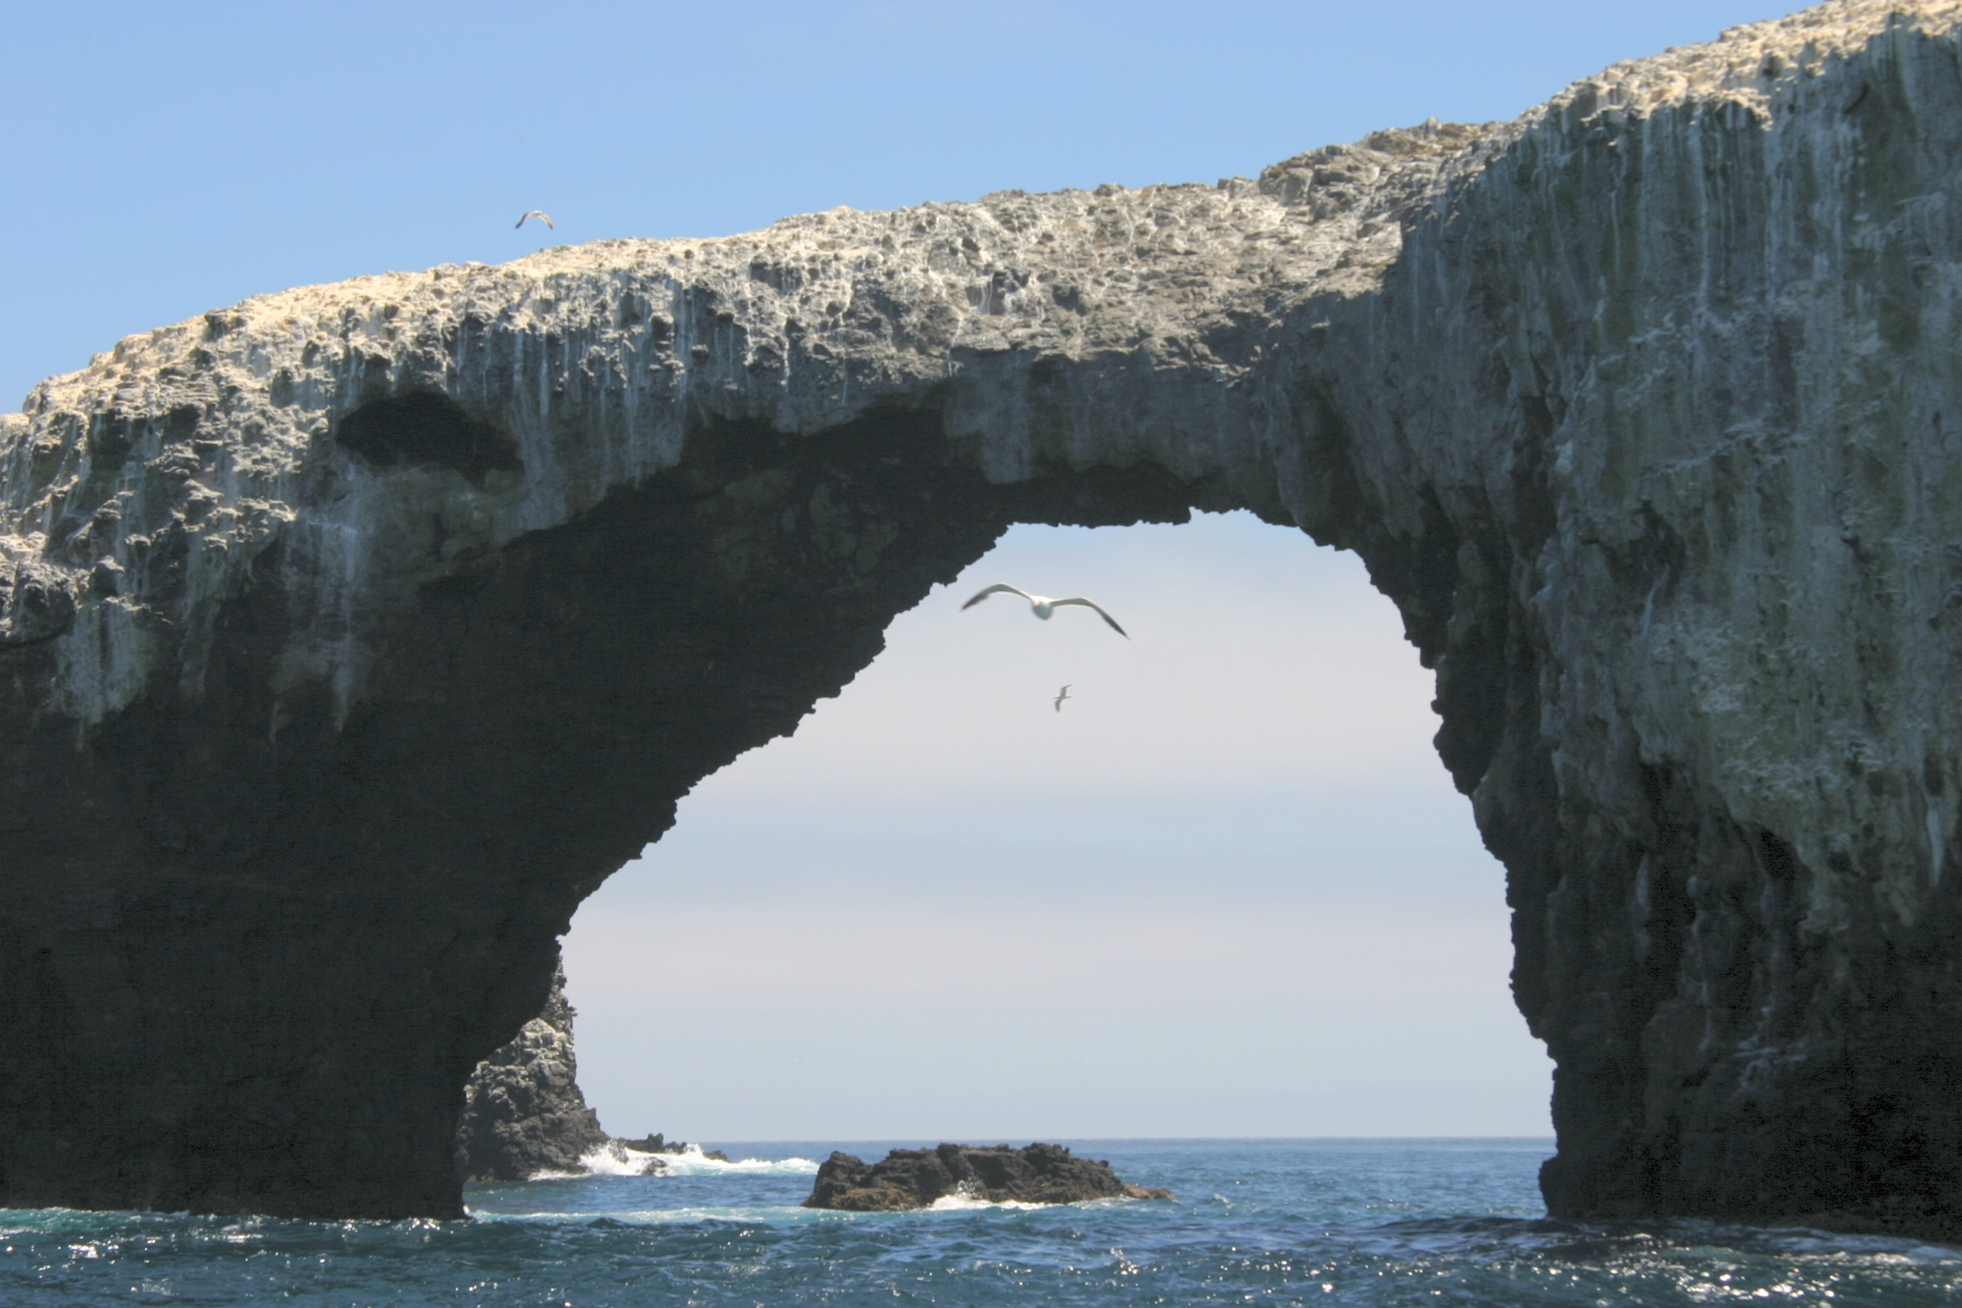
Notes:
… you may recognize this rock as basalt.

Slide 51
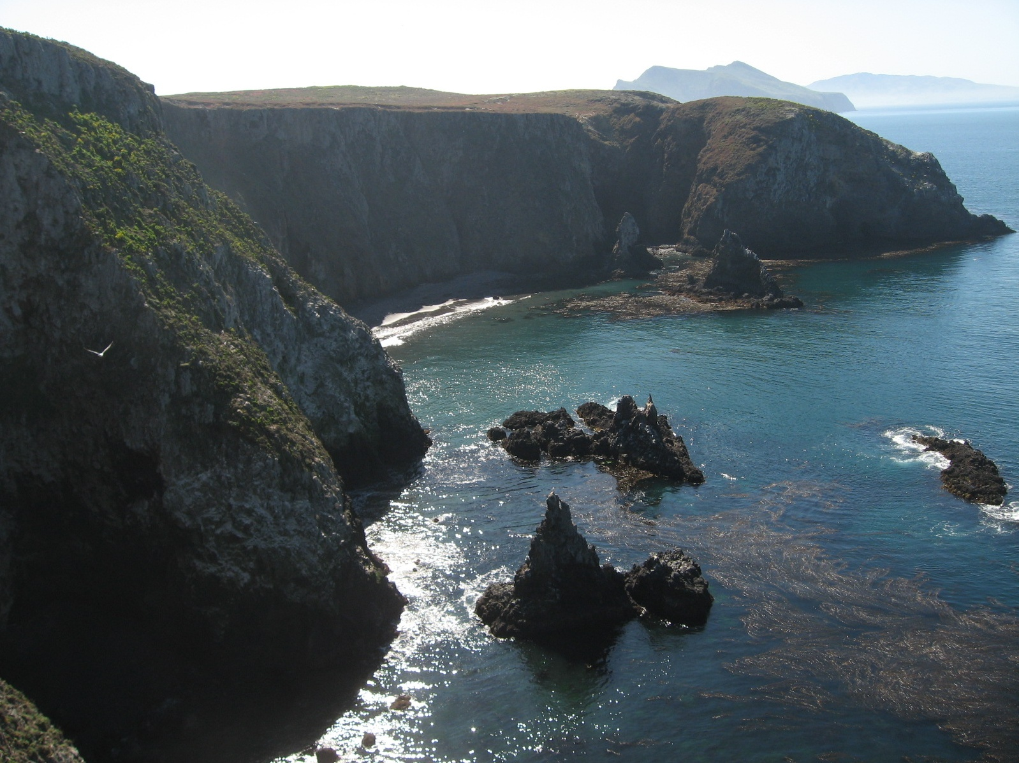
Cathedral Cove, Anacapa
Notes:
Just like on Santa Barbara Island, the basalt on Anacapa is strong enough to hold tall cliffs and formed from submarine eruptions in a transtensional basin within the continental borderland.

Slide 52
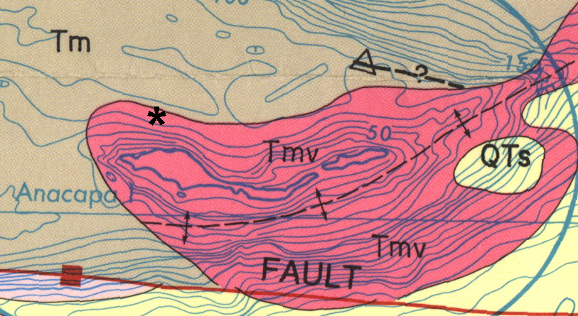
anticline
Notes:
Almost all the rock of Anacapa is basalt and was apparently uplifted by faulting associated with an anticline whose axis lies just south of the island. Such folding is the result of transpression.

Slide 53
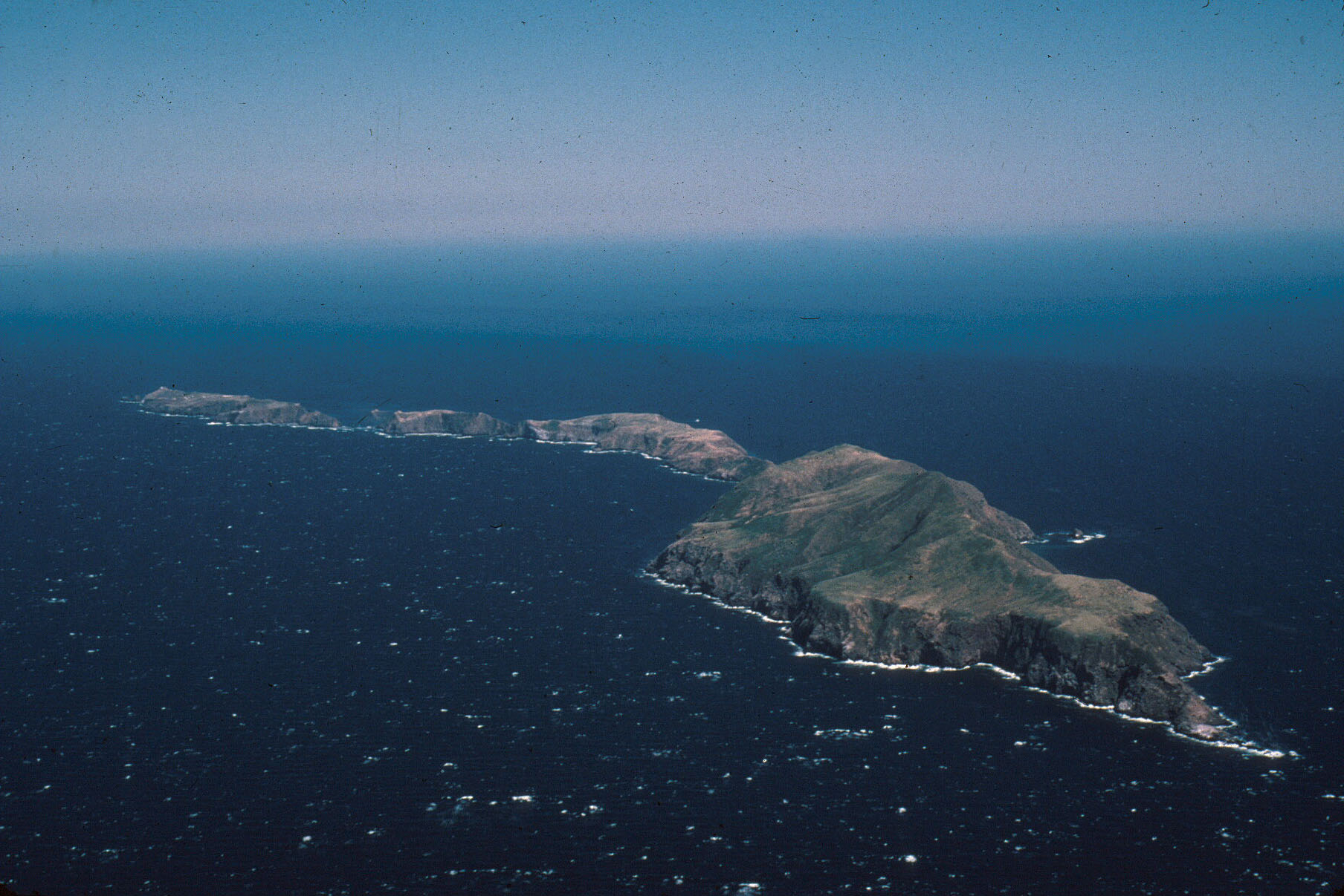
San Onofre Breccia
Notes:
One small area of sedimentary rock on the south side of West Anacapa Island is noteworthy. It consists of an unusual and tectonically important unit called the San Onofre Breccia.

Slide 54
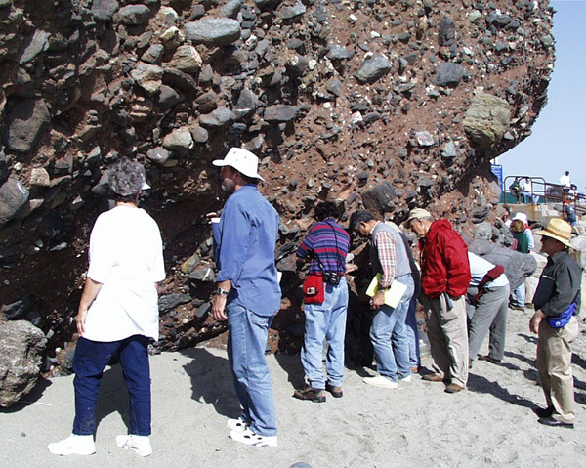
San Onofre Breccia at Dana Point, CA
Notes:
This outcrop of the San Onofre Breccia at Dana Point, CA shows the assorted, large, angular rock fragments that qualify it as a sedimentary breccia. It exerts a seemingly magnetic pull on geologists …

Slide 55
Come closer children and hear my story…
San Onofre Breccia at Dana Point, CA
Notes:
…because of the fascinating story it tells.

Slide 56
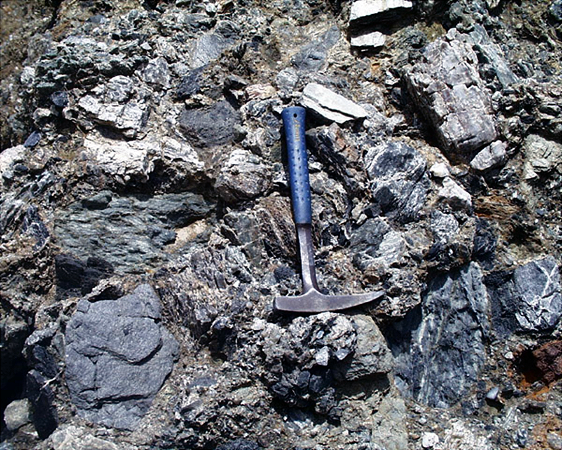
basalt
chert
greenstone
Quartz veins
blue schist
Notes:
Here’s a close-up of the lower Miocene San Onofre Breccia in the Santa Monica Mountains. Note the variety of rock types contained here which is typical of this unit. Where have you seen this assemblage of rock types before?

Slide 57
basalt
chert
greenstone
Mélange
Quartz veins
blue schist
Notes:
That’s right, we saw this type of thing in the Franciscan mélange – only here the rock fragments are supported in a matrix that indicates deposition via submarine debris flows. The blue schist fragments are particularly important in that they must have come from a source region that was subjected to high pressure, low temperature metamorphism. Those conditions are characteristic of metamorphism that takes place in sediments that are carried to great depth next to relatively cool subducted oceanic crust. Thus the presence of the blue schist rock fragments in the San Onofre Breccia indicates that the area eroded to produce these fragments must have experienced a great amount of uplift.

Slide 58
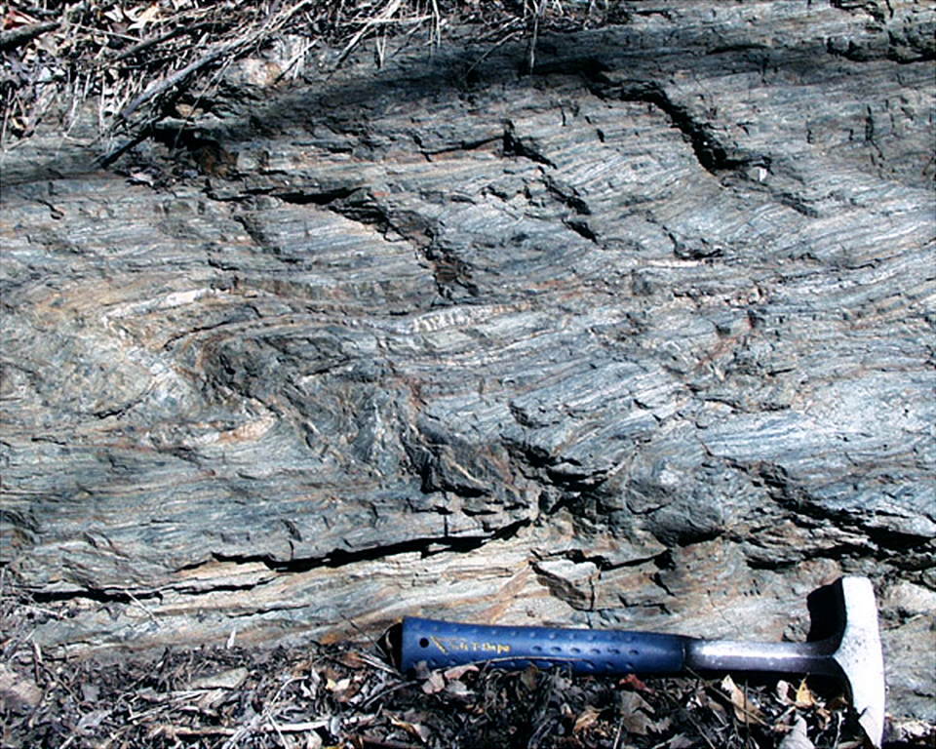
Catalina Schist (blue schist)
Notes:
Although not exposed on Anacapa or any where else in Channel Islands National Park, the source of the blue schist rock fragments in the San Onofre Breccia does outcrop in several nearby areas like Catalina Island and in the Palos Verdes Hills where this photo was taken. Areas like this were the source of the San Onofre Breccia, …

Slide 59
Source for San Onofre Breccia
Notes:
… and are interpreted as uplifted portions of the accretionary wedge that formed during the subduction of the Farallon Plate. Uplift and erosion exposed a mélange of rock types which were transported into adjacent basins via submarine debris flows.

